Slide 1


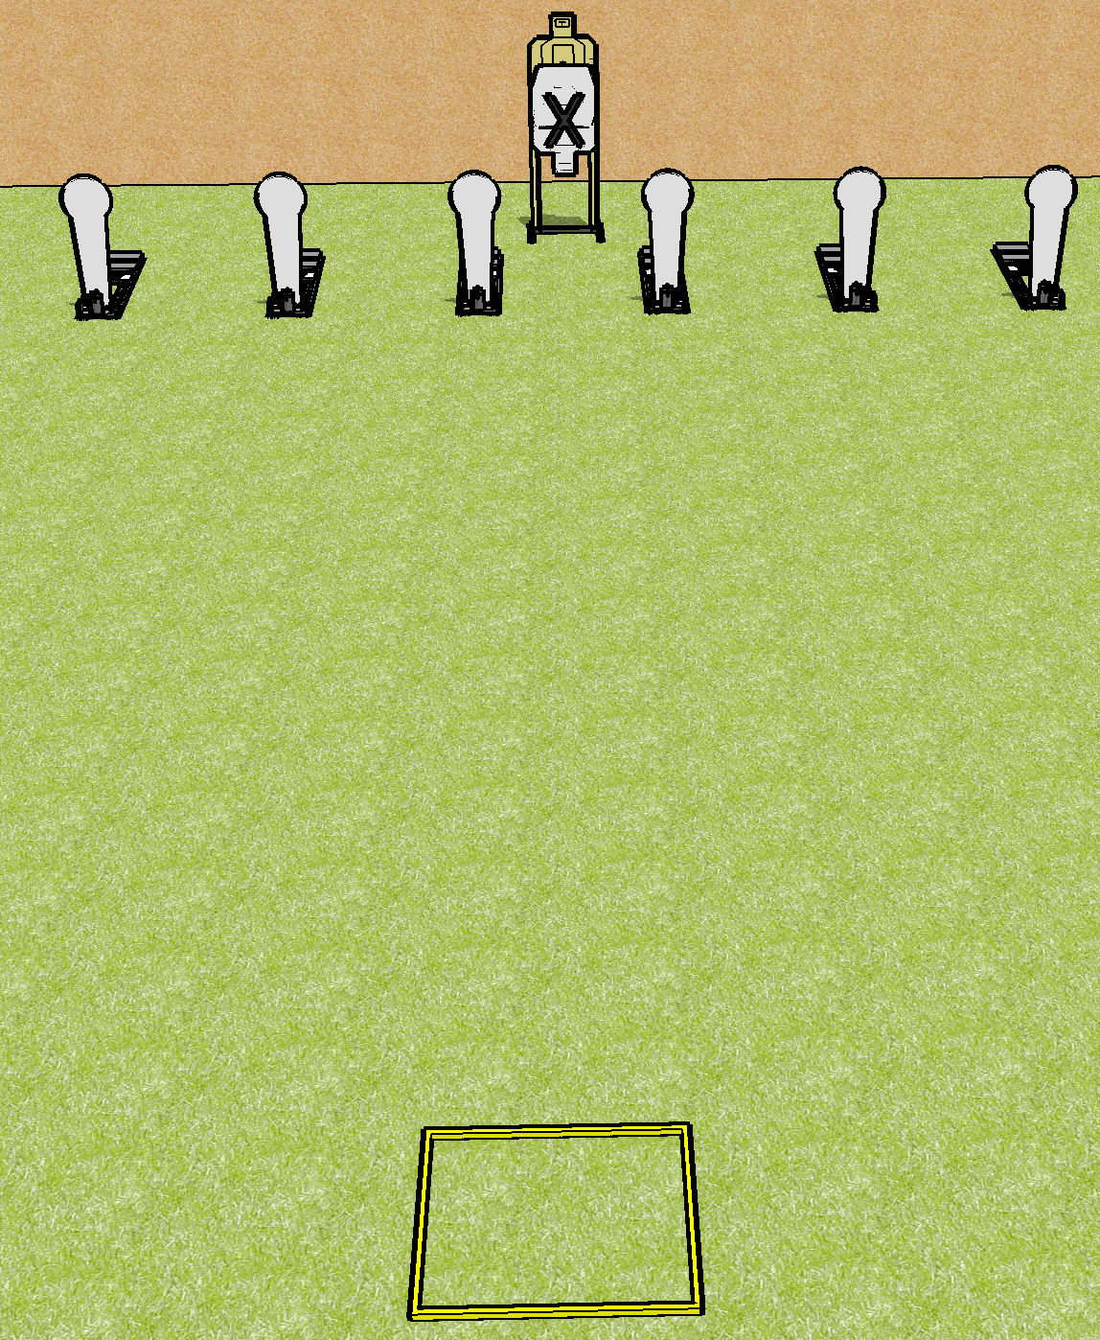
 | Dothan Gun Club – USPSA Match Stick the Reload Course Designer : Drew Coleman
Round Count 10 rounds 1 USPSA 6 colts
Equipment List 1 shooting box 2 targets

Slide 2
Stick the Reload
Written Stage Briefing
Stick the Reload is a 10 round, 50-point, Comstock course of fire. There is 1 USPSA target and 6 steel. The best 4 hits on paper will score and steel must fall to score.
Handgun start position is inside the shooting area facing uprange, wrists above shoulders. Handgun is loaded and holstered.
PCC start position is inside the shooting area, stock on belt. Loaded carbine is held with hands, safety on.
On the audible start signal, engage the steel OR the paper, perform a mandatory reload, then engage the remaining array WEAK HAND ONLY.

Slide 3
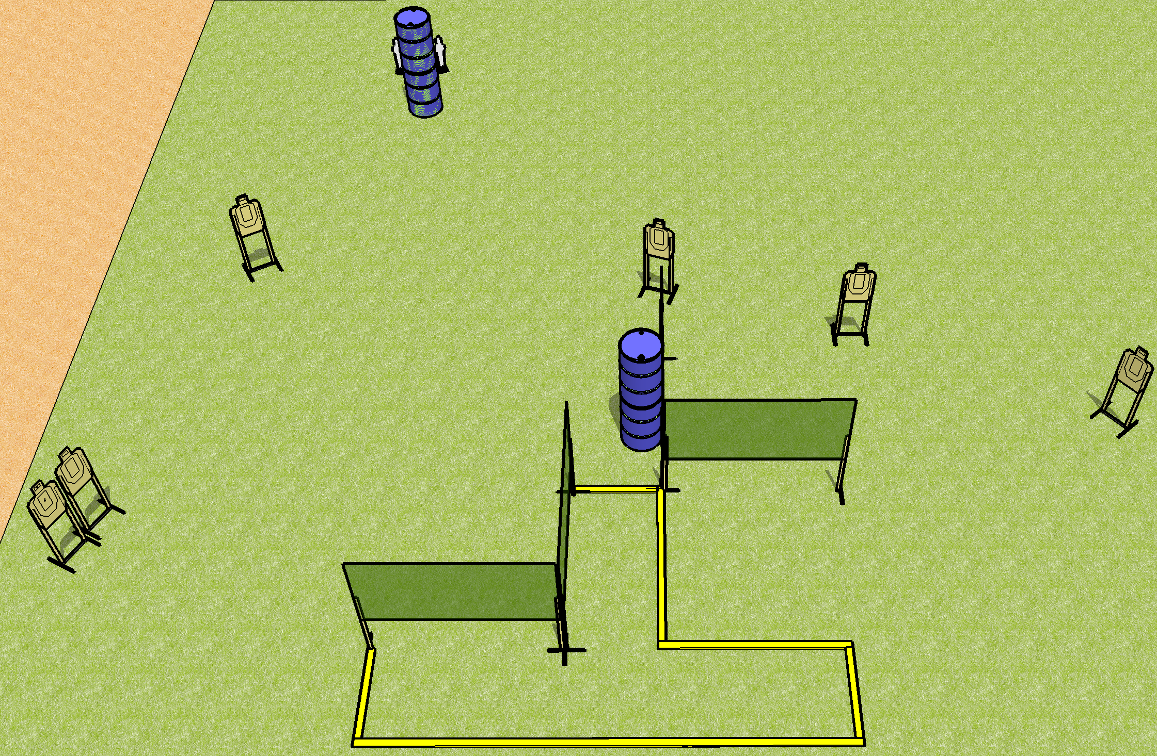
 | Dothan Gun Club – USPSA Match Iffffff You're Finished Course Designer : Drew Coleman
Round Count 20 rounds 6 USPSA 2 mini poppers
Equipment List 6 wall feet 6 targets 3 medium fault lines

Slide 4
Iffffff You're Finished
Written Stage Briefing
Iffffff You're Finished is a 20 round, 100-point, Comstock course of fire. There are 6 USPSA targets and 2 steel. The best 3 hits on cardboard will score and steel must fall to score.
Handgun start position is anywhere inside the shooting area, wrists below belt. Handgun is loaded and holstered.
PCC start position is anywhere inside the shooting area, stock on belt. Loaded carbine is held with both hands, safety on.
On the audible start signal, engage targets as they become available from within the shooting area.

Slide 5
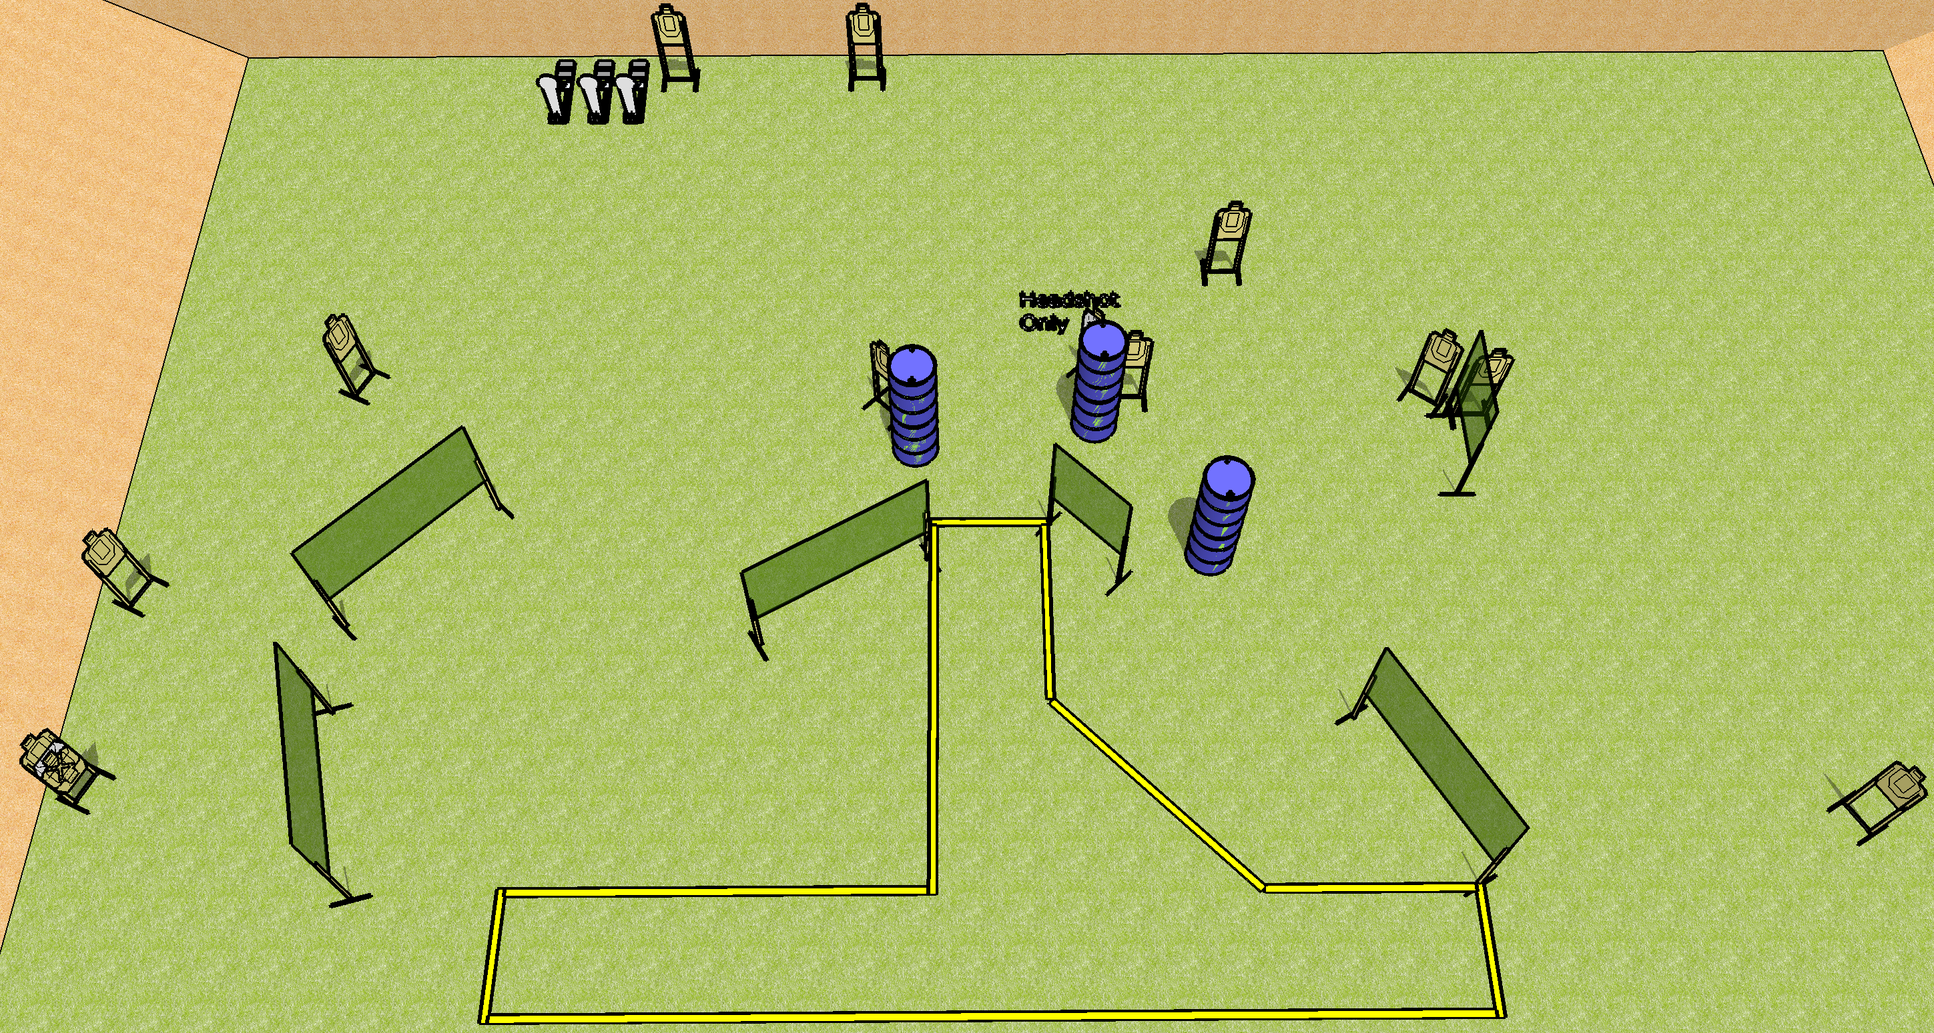
 | Dothan Gun Club – USPSA Match What Fools We Are Course Designer : Drew Coleman
Round Count 29 rounds 13 USPSA 3 Colt
Equipment List 12 wall feet 15 targets (13 + 2 NS) 3 medium fault lines
16’
8’
10’
8’
16’
36’

Slide 6
What Fools We Are
Written Stage Briefing
What Fools We Are is a 29 round, 145-point, Comstock course of fire. There are 13 USPSA targets and 3 steel. The best 2 hits on cardboard will score and steel must fall to score.
Handgun start position is anywhere inside the shooting area, wrists below belt. Handgun is loaded and holstered.
PCC start position is anywhere inside the shooting area, stock on belt. Loaded carbine is held with both hands, safety on.
On the audible start signal, engage targets as they become available from within the shooting area.

Slide 7
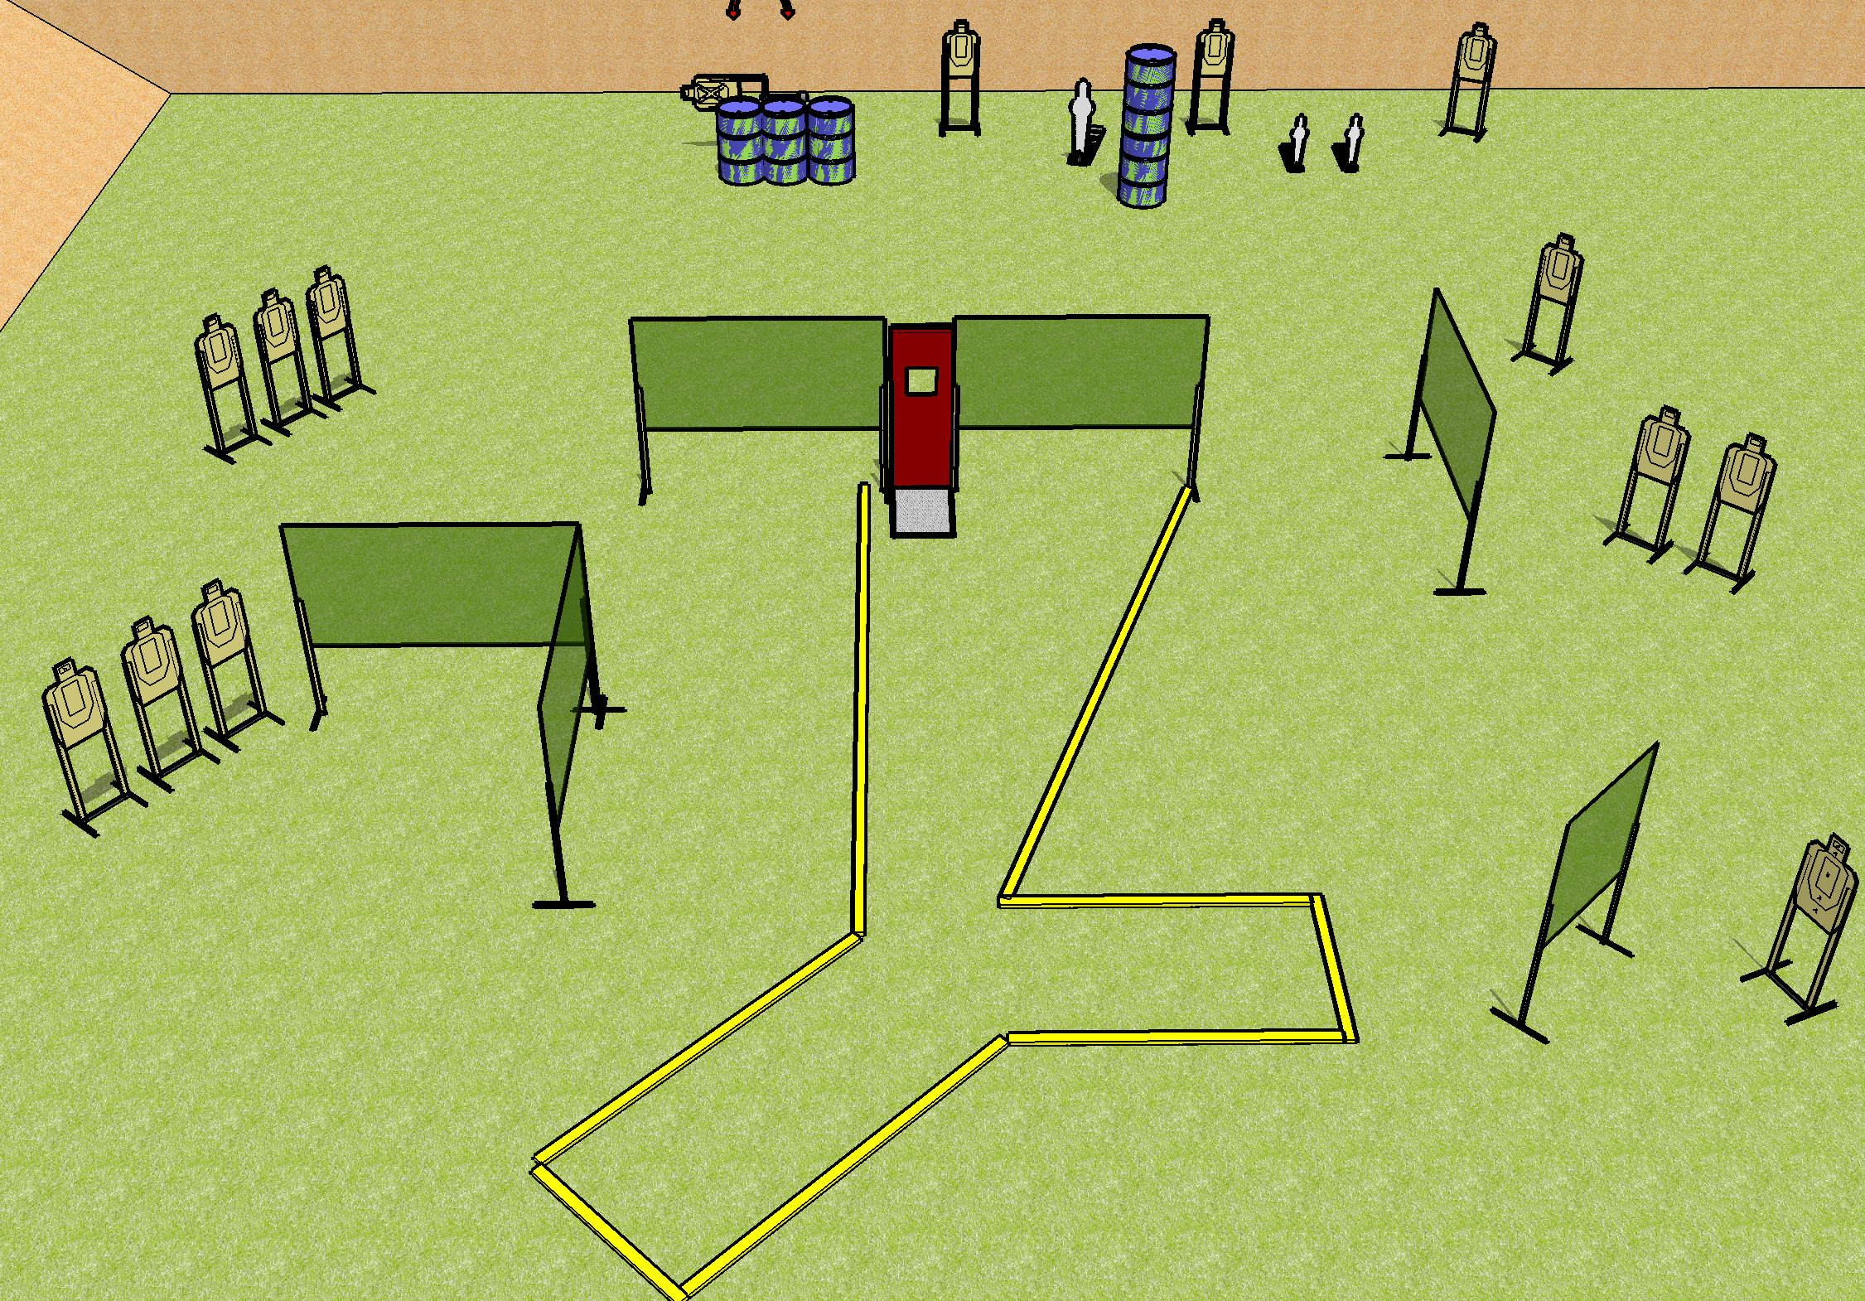
 | Dothan Gun Club – USPSA Match Nightmare Fuel Course Designer : Drew Coleman
Round Count 31 rounds 14 USPSA 1 PP, 2 MP
Equipment List 11 wall feet 2 medium fault lines Pull cord prop 14 targets Swinger + Activator
20’
8’
10’

Slide 8
Nightmare Fuel
Written Stage Briefing
Nightmare Fuel is a 31 round, 155-point, Comstock course of fire. There are 14 USPSA targets and 3 steel. The best 2 hits on cardboard will score and steel must fall to score.
The swinger is activated by the pepper popper and remains visible at rest.
Handgun start position is anywhere inside the shooting area, wrists below belt. Handgun is loaded and holstered.
PCC start position is anywhere inside the shooting area, stock on belt. Loaded carbine is held with both hands, safety on.
On the audible start signal, engage targets as they become available from within the shooting area.

Slide 9
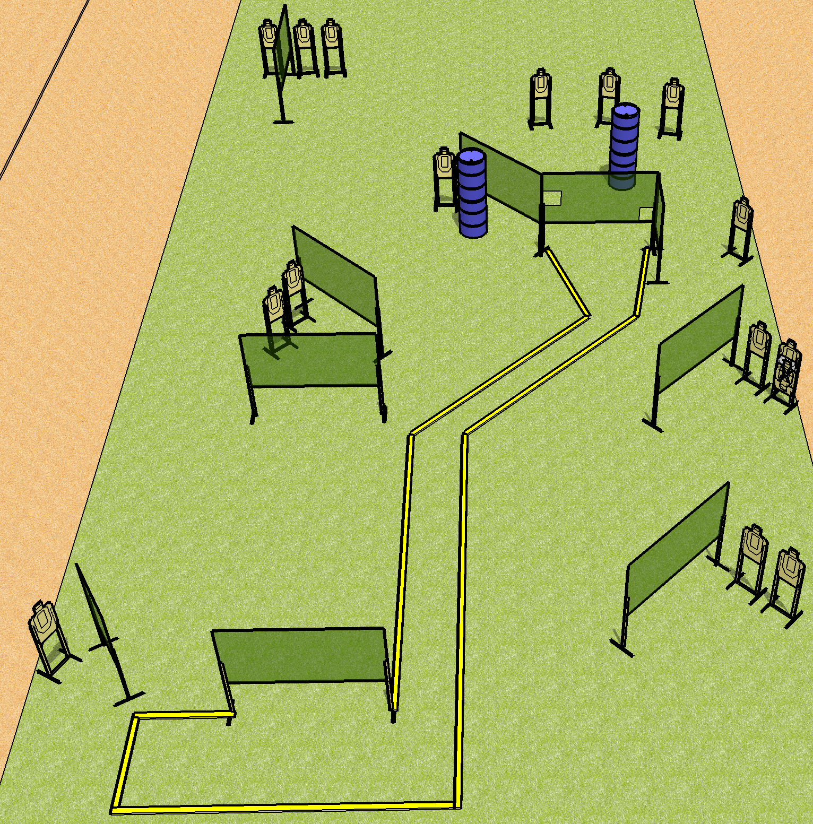
 | Dothan Gun Club – USPSA Match Road to Somewhere Course Designer : Drew Coleman
Round Count 32 rounds 16 USPSA
Equipment List 19 wall feet 2 medium fault lines 17 targets (16 + 1 NS)
8’
16’
20’
16’

Slide 10
Road to Somewhere
Written Stage Briefing
Road to Somewhere is a 32 round, 160-point, Comstock course of fire. There are 16 USPSA targets. The best 2 hits will score.
Handgun start position is both hands touching mark. Handgun is loaded and holstered.
PCC start position is stock on belt, muzzle touching mark. Loaded carbine is held with both hands, safety on.
On the audible start signal, engage targets as they become available from within the shooting area.

